Slide 1
String Matching Algorithms
Md. Rezaul Karim
CSE DU

Slide 2
String matching Problem
We assume that the text is an array T[1..n] of length n and that the pattern is an array P[1..m] of length m<=n.
We further assume that the elements of P and T are characters drawn from a finite alphabet Σ.
For example, we may have Σ={0,1} or Σ={a, b, …., z}.
The character arrays P and T are often called strings of characters.

Slide 3
String matching Problem
we say that pattern P occurs with shift s in text T (or, equivalently, that pattern P occurs beginning at position s+1 in text T ) if 0 <= s<= n-m and T [s+1.. s+m].
If P occurs with shift s in T , then we call s a valid shift; otherwise,we call s an invalid shift.
The string-matching problem is the problem of finding all valid shifts with which a given pattern P occurs in a given text T .

Slide 4
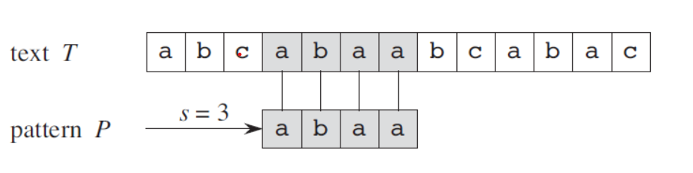
Text: ABABABABABABABAB
Pattern: ABABAB
Text: ABCABCDABCABCABC
Pattern: ABCD
Text: AAAAAAAAAAAAAA
Pattern: AAA

Slide 5
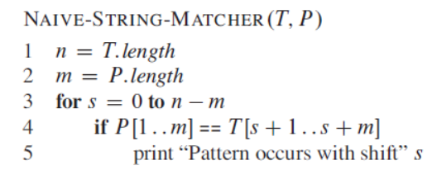
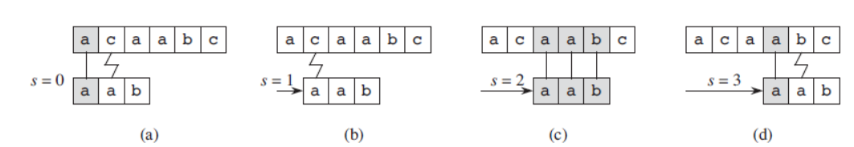
Naïve string-matching algorithm

Slide 6
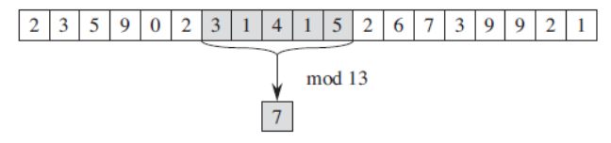
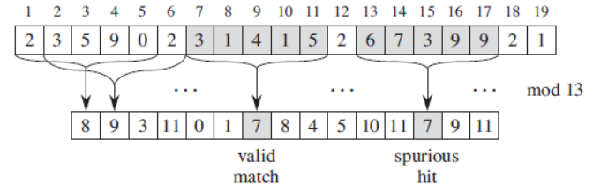
Rabin-Karp algorithm

Slide 7
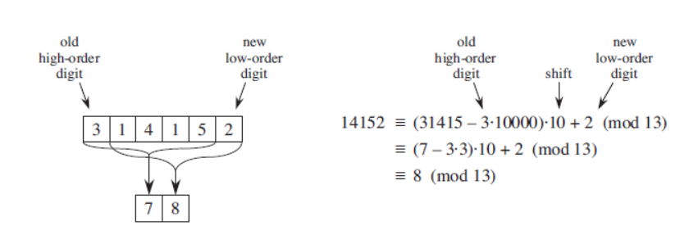
Rabin-Karp algorithm

Slide 8
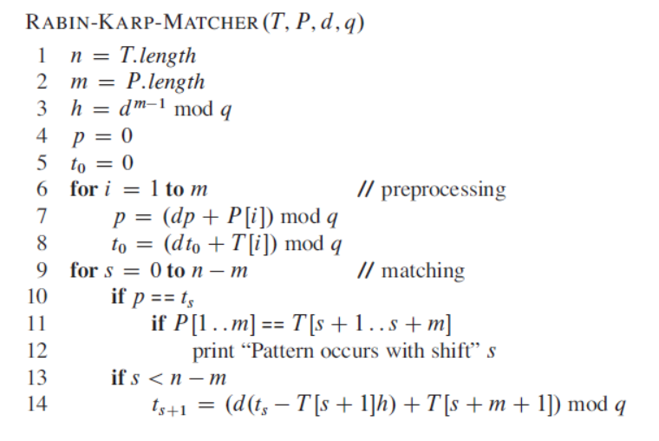
Rabin-Karp algorithm

Slide 9
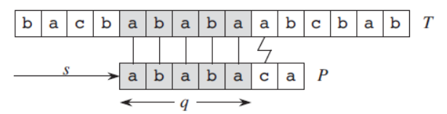
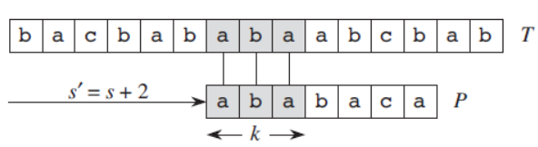
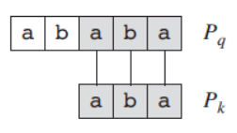
Knuth-Morris-Pratt Algorithm

Slide 10
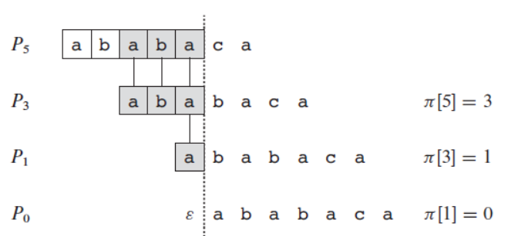
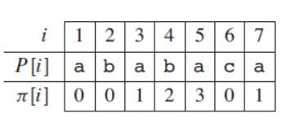
Knuth-Morris-Pratt Algorithm

Slide 11
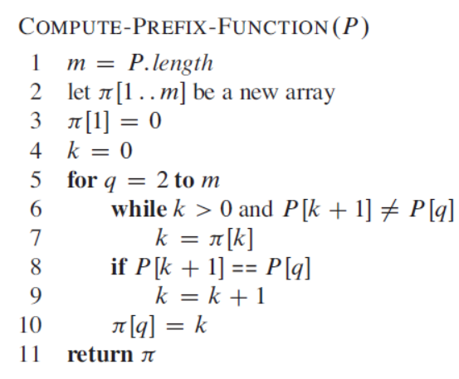
Knuth-Morris-Pratt Algorithm

Slide 12
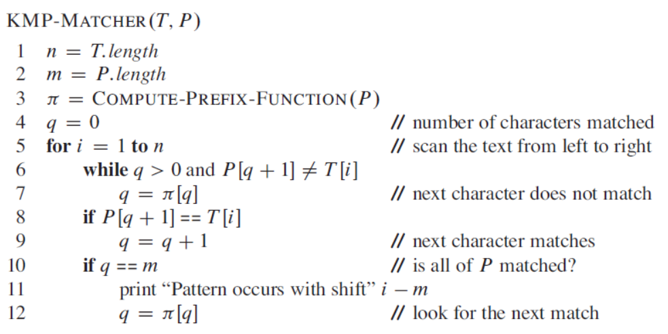
Knuth-Morris-Pratt Algorithm

Slide 13
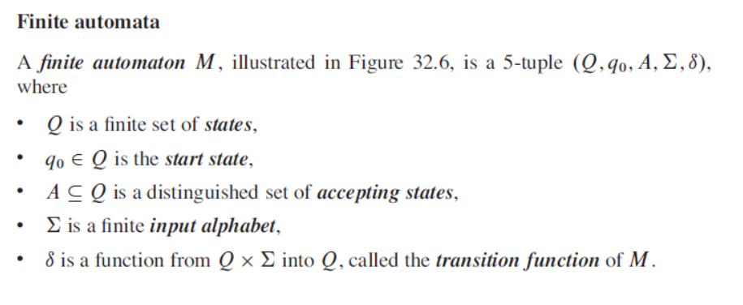
String Matching with Finite Automata

Slide 14
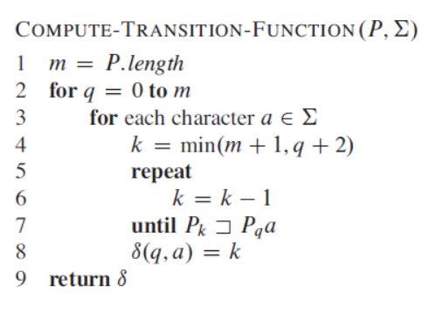
String Matching with Finite Automata

Slide 15
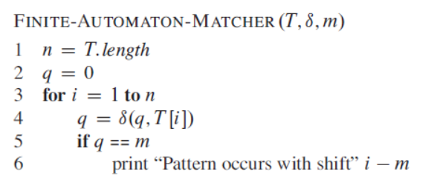
Finite Automata Matcher

